Slide 1
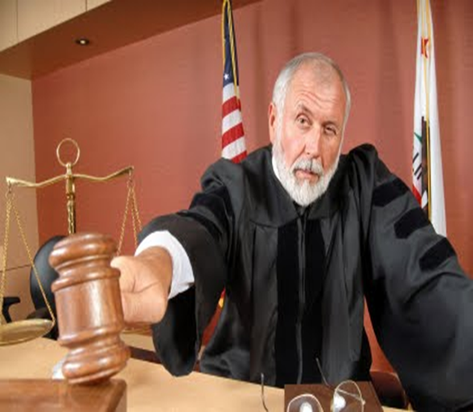
Digital Forensics Update - Enhancing Your Ability to Win Cases

Slide 2
Overview
Digital…it’s how we live!
Areas to consider looking for digital evidence
Critical data on smartphones alone
Cloud computing/Social media
Computer forensics goes beyond e-discovery
Effective Meet and Confer
Current case examples
Defense side computer forensic strategies

Slide 3
Digital…it’s how we live!
Get up in the morning and check:
Text/email messages or Facebook account
On way to work place calls, leave voice mail or email message via smartphone, GPS tracking
At work respond to phone/ email messages
Access accounts on corporate server
Make copies on copy machine
Make a bank transfer online
Data transferred to cloud or storage device

Slide 4
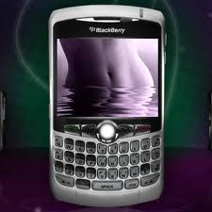
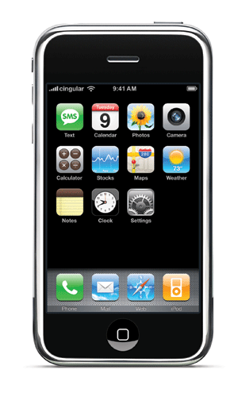
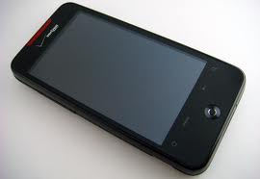
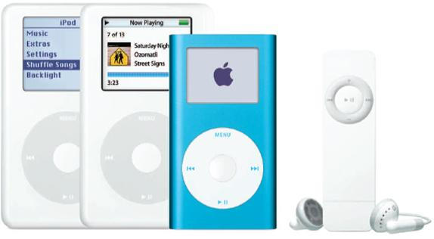
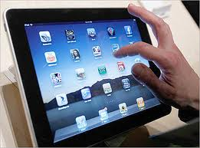
Computer Forensics is now Digital Forensics

Slide 5
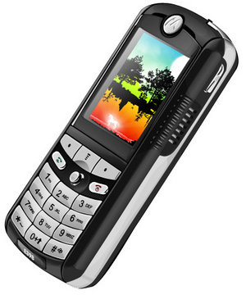
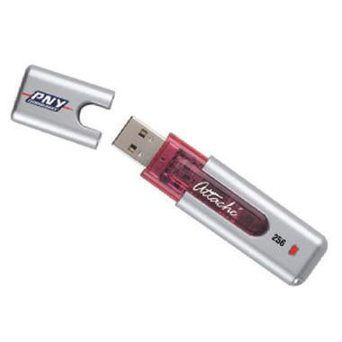
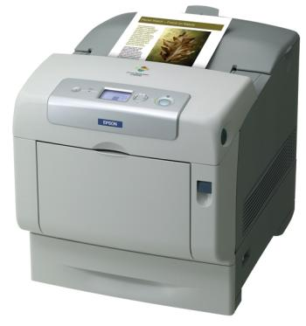
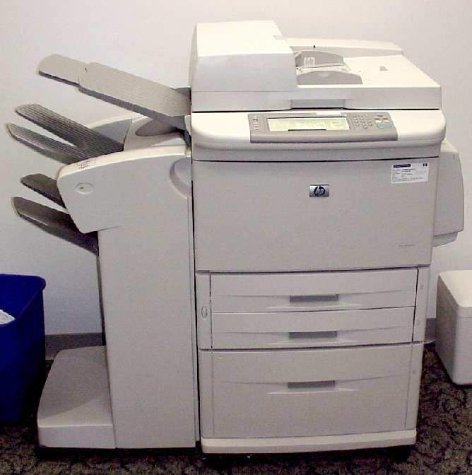
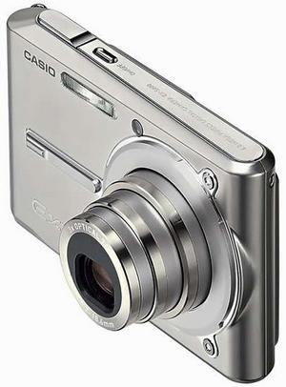
Consider Other ESI Locations

Slide 6
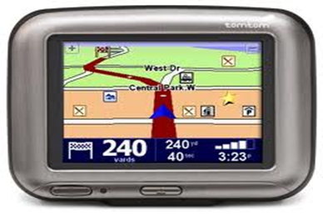
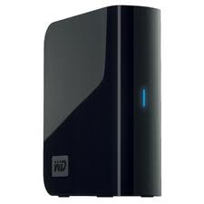
Consider Other ESI Locations

Slide 7
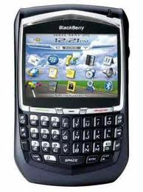
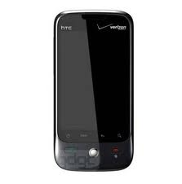
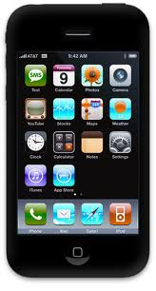
Data on Smartphones
On the Device
Other items uncovered
Call logs
Text messaging
Pictures
SIM card information
Emails and attachments
Phone directories
Internet history
GPS tracking
Remote access programs (e.g. Log Me In, VNC, Homepipe)
Web based email

Slide 8
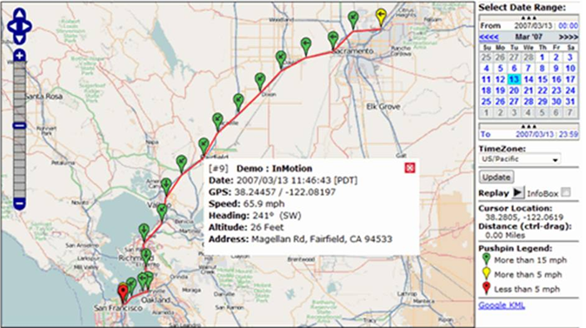
GPS tracking

Slide 9
Get Head Into the Clouds!

Slide 10
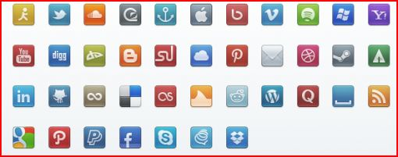
Social Media -Obtainable Data

Slide 11
Recent decision
I see no principled reason to articulate different standards for the discoverability of communications through email, text message, or social media platforms.
-Magistrate Judge Paul Papak
Robinson v. Jones Lang Lasalle Ams., 2012 U.S. Dist. LEXIS 123883 (D. Or. Aug. 29, 2012)

Slide 12
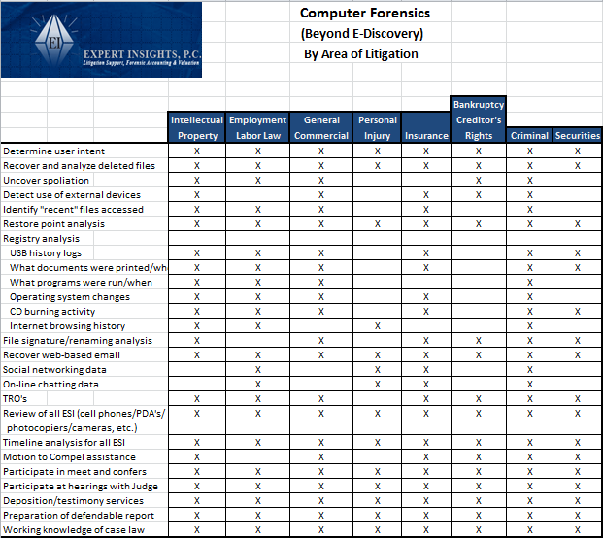

Slide 13
Digital Forensics in Each Stage of Litigation Process
Case Strategy
Discovery
Analysis
Testimony
Data preservation
Identify Electronic Evidence Sources
Assist with Cost/ Benefit Discussions with Clients
Interrogatory assistance
Avoid Exposure to Sanctions
For defense, view what is/is not on computer
TRO
Attend Meet and Confer
Types of Electronic Evidence to Request
Secure Collection & Preservation
Detect use of Storage Devices/ Data Downloads
Motion to Compel
Opposing Expert –
Deposition/Rebuke
Findings
Attend meetings with Judge
Getting all data needed to represent client
Determine user intent
Restoration of
Deleted Files
Review all relevant ESI
Printing/burning activity
Internet activity
Spoliation of Evidence
Knowledge of case law
Defendable Reports
Understandable Testimony
Integrity of Data
Vulnerability Assessment
Opposing Expert Cross Examination
Prior Experience Reputation

Slide 14
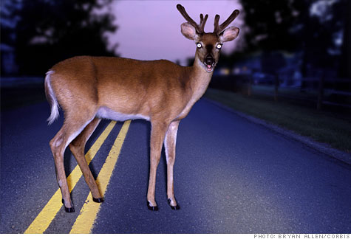
Quick Facts……
93% of information is
created on computer;
90% is never printed!
7.3 billion cellphones
1.3 billion computers
200 cases/year on e-discovery issues

Slide 15
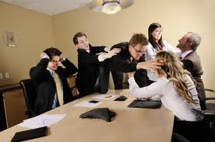
Meet and Confer
Judges want &
need cooperation
Start on right foot
and stay there
New E-Discovery Guidelines issued by
ND California (www.cand.uscourts.gov)

Slide 16
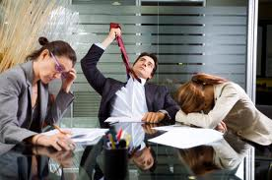
Case Examples… Meet and Confer
Department of Justice was Plaintiff
They “want it all”
Negotiated down from 26 computers to 2
Search terms with millions of search hits
Agree on statistical sampling approach for residual
If not being reasonable, go to Judge
Have digital forensics expert at meetings/ hearings
United States of America vs. Business Recovery Services No. 2:11 CV-390

Slide 17
Case Examples… Spoliation
Launched public relations campaign against
company that fired him (blogs, redirects
from company website, etc.)
Defendant claimed hard drive crashed
Computers provided had little business data
They refused to turn over smartphones
CF determined phone was synced to computer
Text and web-based mail contradicted deposition testimony; disclosed direct involvement with bashing campaign
Sanctions awarded
Aviva USA v. Vazirani 2:11CV-0369

Slide 18
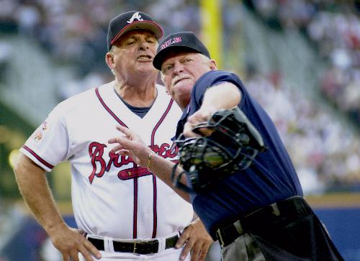
Case Thrown Out
Executives left company and started their own competing business
Examined computers at old and new company
Testified at spoliations hearing
Used same wiping software on both!
“Adverse inference instruction or in conjunction with monetary sanction would be insufficient cure”
Science Care v. Genlife Institute CV2009-032397

Slide 19
IP Case Example – Without Digital Forensics
7/14 (evening) Human Resource Department receives email from EE indicating he/she wants to meet with boss the next day
7/15 Terminates employment

Slide 20
IP Case - Timeline
6/6 Warm fuzzies re: business r/ship (gmail)
6/11 Go to social event together (gmail)
6/15 Forwards resume to competitor (gmail)
6/17 Competitor invites EE to meeting on 6/19 (gmail)
6/19 EE attends meeting at competitor office (gmail)
6/20 (Sat) Install 1TB Backup storage device (USB)
6/20 Accesses company projects on server(recent)
6/20 (eve) Accesses company projects on server(recent)
6/20 (eve) Goes to Google documents account (cookie)
6/21 Apple computer in EE possession (deleted email)
6/22 Project files sent to competitor (gmail)

Slide 21
Timeline (continued)
6/22-6/28 Employment negotiations (gmail)
6/25 EE connects USB thumb drive in laptop (USB)
6/25 EE accesses server/files from home laptop (recent)
7/8 EE connects card reader for first time (USB)
7/8 Empties trash (recover deleted files)
7/14 (evening):
EE connects same backup drive to laptop (USB)
EE accesses project files from server (recent)
Email indicating EE wants to meet with boss (gmail)
EE communicating with b/friend re: computer on BB (phone)
EE access web mail account; forwards “opportunities” file (internet activity)
7/15 Terminates employment (from client)

Slide 22
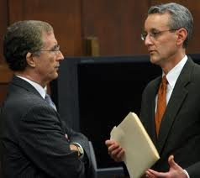
Defense Side Computer Forensics
Is your client telling you “the whole truth”
Be Proactive
Up-front strategy
Information on your clients’
computer they did not put there
Assist with demands of opposition
Turn claims into counter claims
Working knowledge of case law
Rebuke opposing experts’ credentials/methodology/findings
Deposition line of questioning

Slide 23
Thank you!

Slide 24
Craig Reinmuth
CPA, CFF, MST, EnCE, CGMA
President
Expert Insights, P.C. Scottsdale, AZ
(480) 443-9064
www.expertinsights.net

