Slide 1
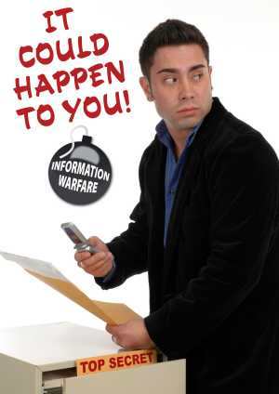
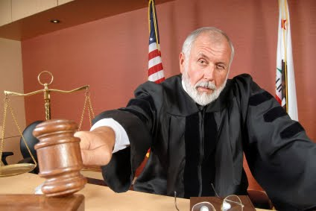
Keep Your Secrets to Yourself
Arizona State Bar
November 4, 2010
Presented by: Craig Reinmuth CPA,CFF, MST, EnCE
Notes:
In today’s economic environment, I’m sure you are seeing more activity in the area of theft of proprietary/trade secret information
Whether executives or employees are being asked to leave, or
Whether they think they are smarter and can do it better than their employer…….
There is an increase in employees taking proprietary items with them when they leave that they shouldn’t be taking
Let’s put you to the test:
Let’s say you’re working on litigation for a client that is suspicious that a former executive took trade secret or other proprietary information with them electronically…..where could they have stored this proprietary information?
Just yell them out……how many different ways could they steal proprietary information?

Slide 2
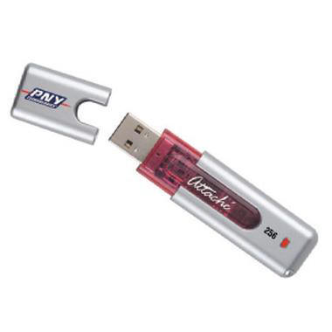
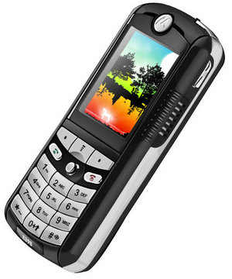
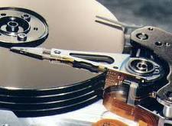
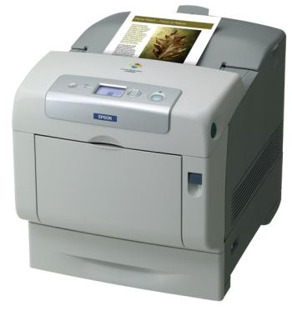
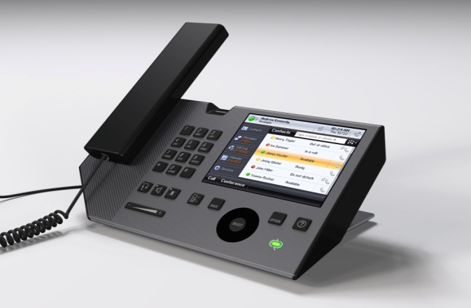
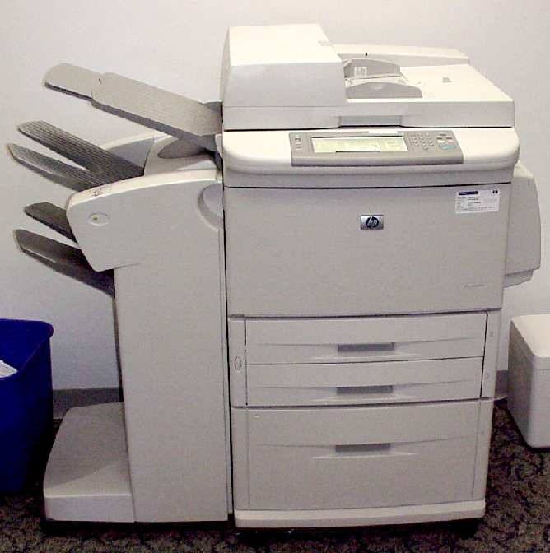
Places ESI is Stored
Notes:
Places electronic data can be stored (get their involvement)
hard drive includes back up drives where they B/U their entire HD before turning corporate computer to their employer
For every location, finding evidence of what they took and when is forensically possible!!
Printer – if they printed it out you can image the drive on the printer and find out what was printed out and when or possibly get print log

Slide 3
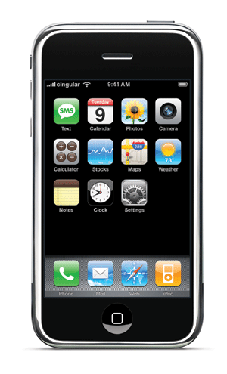
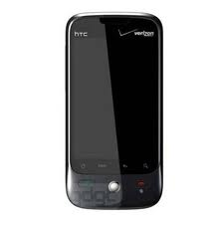
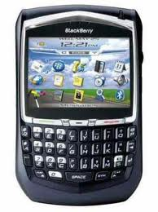
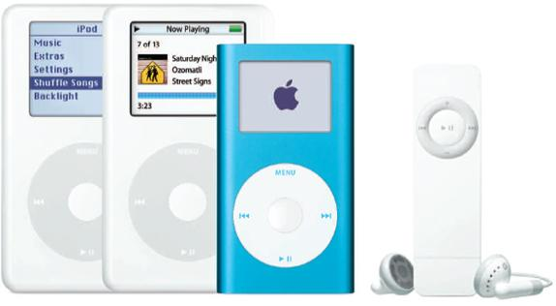
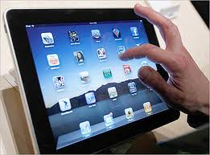
Other Places ESI is Stored
Notes:
Cell phones…….in today’s world, emails are stopping right here and sometimes never makes it to their computer (esp if info is sensitive and something someone doesn’t want anyone else to get ahold of)
Text messages…only on their phones
Web based mail...possibly the only place you’ll find them is right here. (Gmail accounts,Yahoo, MSHotmail)
Ipods – we’ve been involved in cases where proprietary data was download onto an ipod

Slide 4
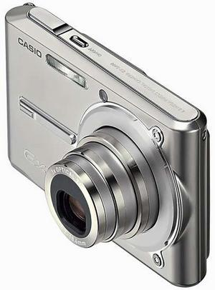
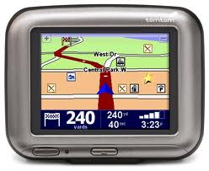
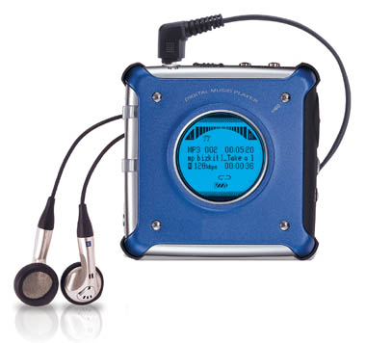


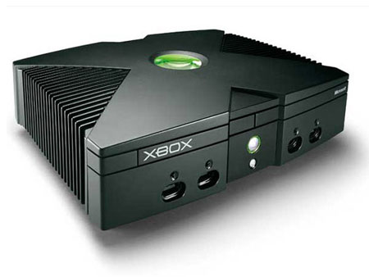
Other Places ESI is Stored
Notes:
Camera’s and SIM cards
GPS devices
“Children’s” electronic play toys

Slide 5
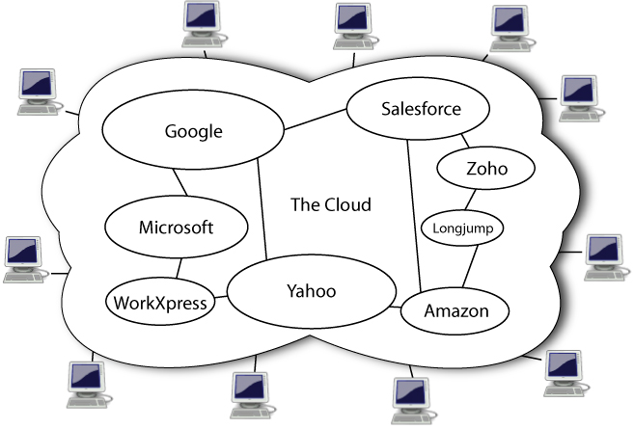
Other Places ESI is Stored

Slide 6
Notes:
A total of 69% of all internet users have used cloud computing
56% use webmail services
34% store photos online
Although %’s for storing computer files and backup files is relatively low, these %’s will be increasing
Quite frankly, I don’t know how you can properly represent your clients without considering electronic modes of communication.
Let me give you two recent examples on two recent case I worked on:
LV case
Next slide

Slide 7
Case Example
6/6 Warm fuzzies re: business r/ship (gmail)
6/11 Go to social event together (gmail)
6/15 Forwards resume to competitor (gmail)
6/17 Competitor invites EE to meeting on 6/19 (gmail)
6/19 EE attends meeting at competitor office (gmail)
6/20 (Sat) Install 1TB Backup storage device (USB)
6/20 Accesses company projects on server(recent)
6/20 (eve) Accesses company projects on server(recent)
6/20 (eve) Goes to Google documents account (cookie)
6/21 Apple computer in EE possession (deleted email)
6/22 Project files sent to competitor (gmail)

Slide 8
Case Example (continued)
6/22-6/28 Employment negotiations (gmail)
6/25 EE connects USB thumb drive in LT (USB)
6/25 EE accesses server/files from home laptop (recent)
7/8 EE connects card reader for first time (USB)
7/8 Empties trash (recover deleted files)
7/14 (evening):
  EE connects same backup drive to laptop (USB)
  EE accesses project files from server (recent)
  Email indicating EE wants to meet with boss (gmail)
  EE communicating with b/friend re: computer on BB (phone)
  EE access web mail account; forwards “opportunities” file (internet activity)
7/15 Terminates employment (from client)
Notes:
Only thing you know is 7/15

Slide 9
Litigation Support Services
E Discovery
Legal hold, collection and preservation
Preserve in place
Collect to preserve
Preserve data integrity
Provide metadata
Processing
Filter
De-duplication
Decompressing compound files
Decryption
Exclude known files
Provide documents within timeframes, file types
Provide documents containing certain search terms
Indexing
Hashing
Delivering in a chosen review platform (e.g. Summation)
Review
Hosting/prepare for attorney review
Notes:
Get feeling for experience in audience
- how many have actively pursued electronic data in litigation?
- How many have used “e-discovery vendors”
- How many have used CF experts?
Here is an overview of “e-discovery” services:
-preserve data integrity
-filter data
-take duplicate files out
-decompress compound files
-exclude known files
-provide documents containing
- certain search terms
- certain time frames
- index and hash files
- host the database for review by the attorney (usually on a .tiff or .html file)
- tell attorneys “have fun this weekend and next”

Slide 10
E-Discovery
Smaller Cases
Processing
Preservation
Identification
Review
Production
Collection
Analysis
Client/in-house
Outside Professionals
Outside Professional and Counsel
Notes:
Electronic Discovery is best described as the collection, preparation, review and production of responsive data from hard drives, servers or other electronic storage media.
This slide presents an overview of who commonly performs these tasks on smaller cases where there is commonly involvement with an outside “e-discovery” vendor or “computer forensic” firm
-usually associated with the lack of in-house resources of the client since they are not commonly involved in litigation

Slide 11
E-Discovery
Larger Cases
Processing
Preservation
Identification
Review
Production
Collection
Analysis
Client/in-house
Paralegals or outside Professionals
Outside Professional and Counsel
Notes:
On larger cases, where there is normally ongoing litigation with the client either the client or the law firm will have staff dedicated to
the preservation, collection and review of electronic data or they may hire an e-discovery firm
Let me ask a question:
- who is responsible for preservation and collection of ESI?
- is it your client
- is it the law firm representing the client?
The answer is YES, or both (Zubulake initiated this joint responsibility; followed by other major decisions such as Qualcomm

Slide 12

 |  |  |  |  | Computer Forensics
 |  |  |  |  | (Beyond E-Discovery)
 |  |  |  |  | By Area of Litigation
 |  |  |  |  |  |  |  | Bankruptcy
 |  |  | Intellectual | Employment | General | Personal |  | Creditor's
 |  |  | Property | Labor Law | Commercial | Injury | Insurance | Rights | Criminal | Securities
Determine user intent |  |  | X | X | X | X | X | X | X | X
Recover and analyze deleted files
Uncover spoliation |  |  | X | X | X |  |  | X | X
Detect use of external devices |  |  | X |  | X |  | X | X | X
Identify "recent" files accessed |  |  | X | X | X |  | X |  | X
Restore point analysis |  |  | X | X | X | X | X | X | X | X
Registry analysis
USB history logs |  |  | X | X | X |  | X |  | X | X
What documents were printed/when |  |  | X | X | X |  | X |  | X | X
What programs were run/when |  |  | X | X | X |  |  |  | X
Operating system changes |  |  | X | X | X |  | X |  | X
CD burning activity |  |  | X | X | X |  | X |  | X | X
Internet browsing history |  |  | X | X |  | X |  |  | X
File signature/renaming analysis |  |  | X |  | X |  | X | X | X | X
Recover web-based email |  |  | X | X | X | X | X | X | X | X
Social networking data |  |  |  | X |  | X | X |  | X
On-line chatting data |  |  |  | X |  | X | X |  | X
TRO's |  |  | X | X | X |  | X | X | X | X
Review of all ESI (cell phones/PDA's/ |  |  | X | X | X | X | X | X | X | X
photocopiers/cameras, etc.)
Motion to Compel assistance |  |  | X |  | X |  | X | X | X | X
Participate in meet and confers |  |  | X | X | X | X | X | X | X | X
Participate at hearings with Judge |  |  | X | X | X | X | X | X | X | X
Deposition/testimony services |  |  | X | X | X | X | X | X | X | X
Preparation of defendable report |  |  | X | X | X | X | X | X | X | X
Working knowledge of case law |  |  | X | X | X | X | X | X | X | X
Notes:
Computer forensics, on the other hand involves the use of a forensic “expert” to perform the tasks of e-discovery plus a thorough examination of the hard drive, server, etc.
To help you understand the difference between “e-discovery” and computer forensics, this slide indicates the level of services “Computer Forensics” can provide over and above e-discovery
-across the top from L to R, this slide indicates the types of litigation we have used computer forensics in
-today, we’ll be focusing on the first column “intellectual property” and we’ll cover briefly what I mean by the line items in the first column

Slide 13
Computer Forensics
(Beyond E-Discovery)
Determine user intent
Timeline analysis/recent files
Recover/analyze deleted files; unallocated space
Uncover spoliation
Detect use of external storage devices
Review “restore points”
USB History logs
Documents printed/when
Programs – when run
Operating system changes
CD Burning Activity
Internet Browsing History
File signature/renaming
Recover web-based email
Social Networking data
On-line chatting data
Assistance with “what to ask for”
All ESI (cell phones, PDA, etc)
Notes:
As we saw in the case example, over and above getting you responsive documents,
Computer forensics can tell you user intent
- at any point in time that is important to the litigation; restore point = snapshot
Put together a timeline based on all ESI available
e.g. -when they began to communicate with other parties they eventually teamed up with
-when certain employees began to plan for their departure
- what corporate files they accessed and when
-it is amazing what story is told when a “timeline” is put together combining all parts of the hard drive.
At any of these key dates we can determine not only what files were accessed, but:
--what files were printed, burned, deleted, and possibly transferred
Deleted files – not a matter of “if” they deleted files, but how many
- CF can recover most of the deleted files; e-discovery cannot
- e-discovery captures “live data” – those that are readily available without restoration of deleted files
Spoliation – One reason I love CF…a “Win/Win”
-if they don’t spoliate evidence, great we’ll get the facts, get to the truth and find out which party is right
-if they do spoliate evidence, they are in a worse situation
--sanctions can include:
--recover fees of attorney and expert
--adverse inference instructions
--throw case out and rule in your favor
Science Care example- testified yesterday. Three executives left company because they thought they could do it better on their own.
--we acquired HD’s, became suspicious that certain files that s/h been there (associated with their normal duties) were not
--we searched hard drive for spoliation programs
--determined they used the wiping program evening b4 and morning of turning comp in
--ME indicated judge was convinced spoliation took place; just a matter of appropriate level of sanctions
--this type of assistance on your cases can put things immediately in your favor in eyes of judge
Detect storage devices (refer to next slide)
--connect the dots between when devices were connected and what files were accessed just before and after the storage device was connected to computer
--With CF, really looking into HD really tells a story that you cannot get from e-discovery
Deleted files - not a matter of “did they delete files”, but how many
- did they violate litigation hold
-deletion of email’s with other crooks they don’t want you to see
-downloading of files onto a storage device they don’t want anyone to see; delete them from computer; but available for future use

Slide 14
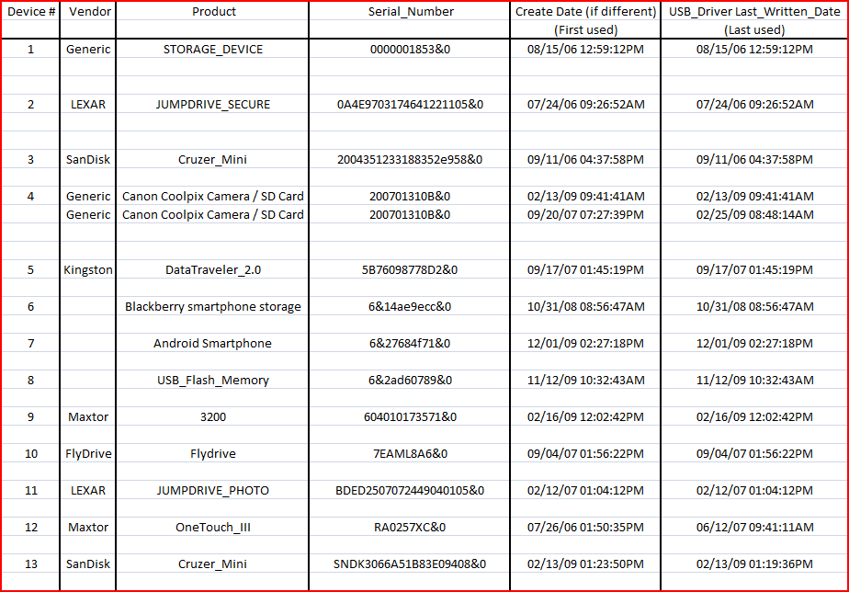
Sample USB Report
Notes:
USB reports around critical times
--shows make model and serial # of storage device, date/time it was first connected to the computer and last date/time
--in our example, then connect the dots between when devices were connected and what files were accessed just before and after the storage device was connected to computer
Request them to produce the devices and find out what proprietary doc’s were placed on them
--on one case we generated this report, asked them to produce certain storage devices, which they did
--determined they tried to delete proprietary files they had on there; we were able to recover them….case closed!
Sometimes this is enough
-USB reports showed suspicious activity (AFI)
-AZ Judge “find it or else” and the other side settled the case
-WI took into consideration with everything else. Depends on the judge and how much weight but it cannot hurt.
If USB not available, think outside of box
-AFI acquired database from server of new insurance company; determined all client data had been transferred directly to server (without use of corporate computer)
Look back couple of months prior to their resignation
-get printout from your client indicating customer files they accessed and downloaded or printed out from the server
-determined the reports they were generating were not in line with normal business operations in previous 12 months
Can you see how much this can tell the story?
Note the types of USB devices this USB log will tell you about:
- camera’s, BB’s, Smartphones

Slide 15
Computer Forensics
(Beyond E-Discovery)
Determine user intent
Timeline analysis/recent files
Recover/analyze deleted files; unallocated space
Uncover spoliation
Detect use of external storage devices
Review “restore points”
USB History logs
Documents printed/when
Programs – when run
Operating system changes
CD Burning Activity
Internet Browsing History
File signature/renaming
Recover web-based email
Social Networking data
On-line chatting data
Assistance with “what to ask for”
All ESI (cell phones, PDA, etc)
Notes:
Print files – 3 files generated when enter print command…gotta know where to find them
-print log
-two temporary files
Programs
- When Corporate programs were run containing confidential data and when
– were wiping programs run /hiding their tracks
Operating System changes – clean slate computer (Vortex example). Executive had a lot of pride in the design work he had with the employer and felt the work was his – not what his employment agreement indicated.
-we were able to determine the OS reinstalled and upon further discovery that he had downloaded his entire hard drive onto a backup drive, then cleaned his corporate computer, then placed certain select files from the B/U drive back onto his corp LT, trying to make it look as if nothing happened.
--Our costs were paid for; and this had a bearing on the rest of the issues in the case.
--reminded me of a judges description in a recent case “Gang that couldn’t spoliate straight”
CD Burning history – another way they can take prop files with them.
Details depend on program used for burning
Internet browsing history – accessing g-mail account
-our example where she sent a gmail to herself and attached key corporate doc’s (has happened more than on one recent case)
File signature renaming
-e-discovery – obtain former exec’s new computer and request Word documents…if extension is changed by renaming file – won’t get it specific dates
-CF can determine what file extensions were changed and when
Social Networking sites - As everyone knows, this is a huge new area and if you’re not looking here you might miss out on
- our example….important informal “chatting” about issues relevant to litigation
- one case “Had a bad day today, my client lied in court”
- NEXT SLIDE

Slide 16
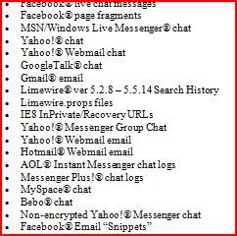
Social Networking / Web Based Mail
Notes:
we have a new software program that will pull all kinds of internet evidence from the computer re:
-social networking sites
-chat rooms
-web based email
How people talk in chat rooms and web based mail reminds me of Art Linkletter used to say: “Kids say the darndest things”. I amazed.
Back one slide?
- a good computer forensic firm will alert you as to where to get information from any and all electronic data sources

Slide 17
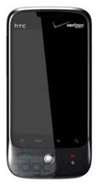
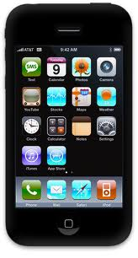
Smartphones
(Blackberry, Droid, iPhone)
On the Device
Other items uncovered
Call logs
Text/Instant messaging
Pictures
SIM card information
Emails and attachments (e.g. Outlook)
Phone directories
Internet history
Remote access programs (e.g. Log Me In, VNC, Homepipe)
Web based email – specific providers
Where else to go to get info
Notes:
Let’s face it, if someone is considering leaving the Co. or doing something sneaky with the competition, where are they going to communicate?.....right here. (not on their corporate computer)
Concerning Smartphones, here are examples of the kind of data you can extract
-call logs – who they have been calling and when (incoming and outgoing)
-text messaging – I don’t even need to remind you about the increasing level of communication that takes place with text messaging
but if you want to obtain it, you need to forensically acquire their phone
--if delete text messages, likely can be recovered, unless BB or Droid
-Sim card is storage area for phones, CF can acquire
-emails and attachments, phone directories, internet history – all can be forensically recovered and analyzed
Other items…smartphones are clearly like a small computer. When a smartphone is forensically acquired,
--can determine if they have been logging into company server via use of common programs such as….
--could be downloading/transferring files from the palm of their hand
--web based email – good CF expert can tell you which providers they have been using and give you tips on how to get the information from the provider…..need to act quick though….normally only stored 30-90 days

Slide 18
How to Convince Your Clients to Use Computer Forensics
Zubulake – “Virtually all cases involve the discovery of electronic data”
Greater likelihood of getting the data you need to properly represent your clients
Avoid exposure to sanctions (at client and attorney level)
Potential for expert fees to be paid for by other side
Case dismissal
Greatly Enhance Chances for Winning
Potential for turning claims into counter-claims
Notes:
The risks in not pursing ESI are great:
Sanctions: 103 e-discovery decisions in first 5 ½ months of 2010
Increasing levels of sanctions for
clients not preserving data and
for the attorney not properly supervising steps taken to preserve
Qualcomm attorneys first risked losing license; ended having to teach an ethics class
Enough of the negative things….
If your clients are increasingly budget conscious, remind your client of:
1-5 above
Turning claims into counter claims
We have done this on a number of cases where based on information we found on Plaintiff’s computers, were able to turn case against them
E.g. Insurance client. Agents left to go with another insur comp. They sued insurance company for holding back on their extended earnings (their form of pension).
We looked at their computer and determined a number of violations on their empl agmt -- solicitation of clients in violation of one-year non-compete; stealing of client lists and other customer data
We have had attorneys who knew CF was the way to go, but could not convince their client
- I went out to the client with the attny and met with the client to convince them of the benefits (as well as the risks) of pursuing ESI

Slide 19
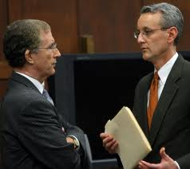

Defense Side
Computer Forensics
Is your client telling you “the whole truth”
Be comfortable in Being Proactive
Assist with Up-front strategy
Assist with demands of opposition
Turn claims into counter claims
Working knowledge of case law
Rebuke opposing experts’ credentials/methodology/findings
Deposition line of questioning
Notes:
Normally get aggressive with discovery when you represent plaintiff
- you want to get all the dirt you possibly can
On the defense side, there are also benefits of considering the use of CF:
- client telling whole truth….Boardman example
-allow you to be comfortable in being proactive in your approach and strategy to the litigation
-when opposing counsel calls you to obtain ESI from your client, you know in advance what is and is not on your clients computers
--comfortably tell him, “sure will make the data available to you….have at it” (knowing they will be wasting their time)
-demands of opposition – good CF expert can sit together at meet and confer; let you know what demands are reasonable/unreasonable
-wkng knowledge – I have MST/working knowledge on how to review and apply case law and I stay on top of recent cases in area of electronic discovery
--as case progresses, light bulbs go on as to how case law might apply to the case at hand
Others – self explanatory

Slide 20
Other Potential Needs for
Computer Forensics Expert
TRO – collection/review of electronic devices
Review of other ESI
Motion to Compel Assistance
Motion for Spoliation Assistance, including testimony
Participate in Meet and Confer
Participate in Meetings with Judge
Deposition/testimony services
Preparation of defendable report
Working knowledge of Case Law
Notes:
(Quick slide)
Some of which we’ve previously touched on
TRO…drop down to
Meetings with Judge…judge was delighted the CF was there. He had a lot of questions as to what was/was done on computer. Got a straight answer; allowed enhanced progress at the meeting
Spoliation testimony – I did this earlier this week

Slide 21
Computer Forensics in Each Stage of Litigation Process
Case Strategy
Discovery
Analysis
Testimony
Data preservation
Identify Electronic Evidence Sources
Assist with Cost/ Benefit Discussions with Clients
Interrogatory assistance
Avoid Exposure to Sanctions
For defense, view what is/is not on computer
TRO
Attend Meet and Confer
Types of Electronic Evidence to Request
Secure Collection & Preservation
Detect use of Storage Devices/ Data Downloads
Motion to Compel
Opposing Expert –
Deposition/Rebuke
Findings
Attend meetings with Judge
Getting all data needed to represent client
Determine user intent
Restoration of
Deleted Files
Review all relevant ESI
Printing/burning activity
Internet activity
Spoliation of Evidence
Knowledge of case law
Defendable Reports
Understandable Testimony
Integrity of Data
Vulnerability Assessment
Opposing Expert Cross Examination
Prior Experience Reputation
Notes:
This slide pulls everything together as to how a good computer forensics expert can help you in every stage of the litigation process
If you believe you will need someone to testify, e-discovery vendor not qualified
-qualified CF expert can and tell you everything that is on that computer.

Slide 22
Summary
Zubulake – “Virtually all cases involve the discovery of electronic data”
Computer Forensics Can Help Your Clients Keep Their (Trade) Secrets to Themselves
It is a Win/Win
Goes Well Beyond E-Discovery
Determines User Intent; Provides “Timeline” of Activity
Considers all Potential Sources of ESI
Can Greatly Enhance Your Chances for Success
Avoid exposure to sanctions
Should Be Considered by both Plaintiff and Defense
Notes:
I hope this presentation has helped you understand how CF can assist you greatly in allowing your clients keep their trade secrets to themselves.
Here is a summary (time???):
Well beyond e-discovery; obtains critical info that can only be obtained via CF
All potential sources – increasing amount as time goes on.
Quite frankly, don’t know how a case of any decent size can afford to not utilize the benefits of CF

Slide 23

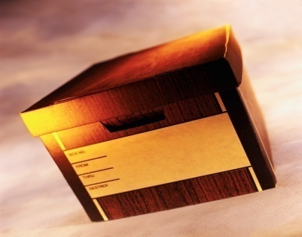
Right, what’s a “Gigabyte”
Document = 26,214 bytes
Box of documents = 2,000 pages or
50 megabytes
Truck of boxes =
1 million pages or 25 gigabytes
Notes:
Costs:
Good CF expert will keep counsel and their clients apprised as to:
- what they are finding
other avenues that can be pursued, chances of additional relevent info being there and the potential benefits
ED and CF can work together
Can it be expensive, yes
Can your client not afford to….likely not.

