Slide 1
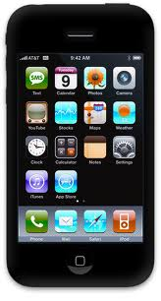
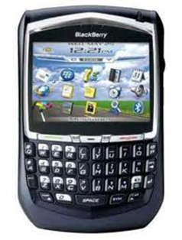
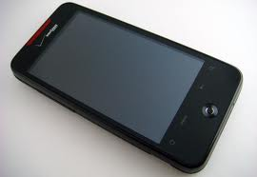

Phone Forensics
- Smart phones are Pretty Smart!
Presented by: Craig Reinmuth CPA,CFF, MST, EnCE
President, Expert Insights, P.C. Scottsdale, AZ
(480)443-9064 www.expertinsights.net

Slide 2
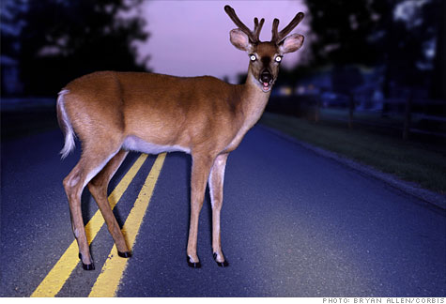
93% of information is created on computer

Slide 3
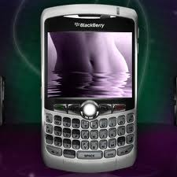
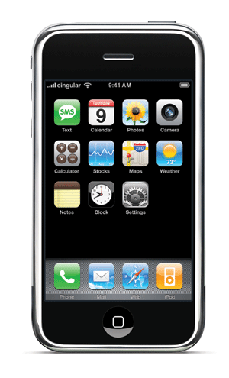
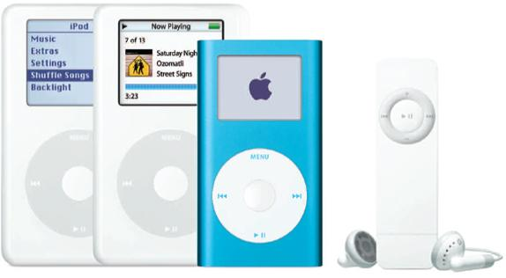
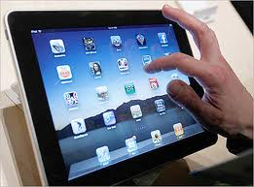
Computer Forensics is now
Digital Forensics

Slide 4

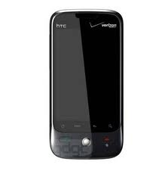
Smartphones
(Blackberry, Droid, iphone)
On the Device
Other items uncovered
Call logs
Text/Instant messaging
Pictures
SIM card information
Emails and attachments (e.g. Outlook)
Phone directories/calendars
Internet history
GPS tracking
Sync files
Web based email – specific providers
Where else to go to get info

Slide 5
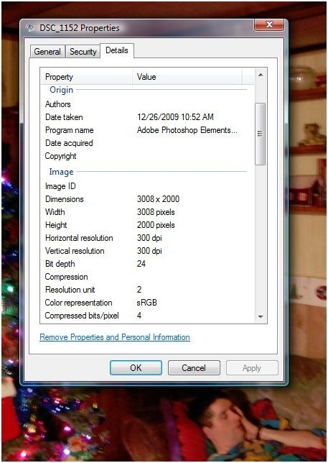
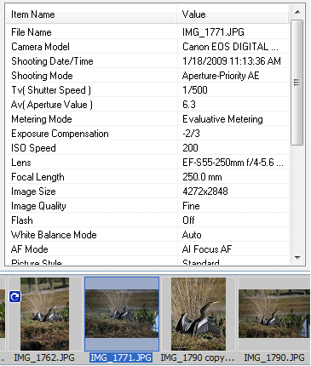
Metadata on Cameras

Slide 6
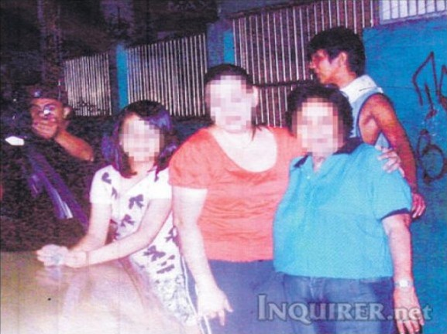
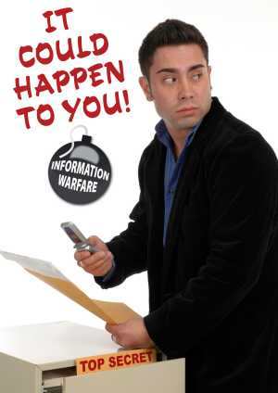
Cellphones and Pictures

Slide 7
Smartphones
(Blackberry, Droid, iphone)
On the Device
Other items uncovered
Call logs
Text/Instant messaging
Pictures
SIM card information
Emails and attachments (e.g. Outlook)
Phone directories/calendars
Internet history
GPS tracking
Sync files
Web based email – specific providers
Where else to go to get info

Slide 8
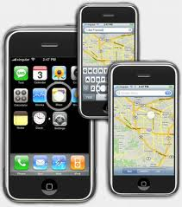
iphone GPS Tracking

Slide 9
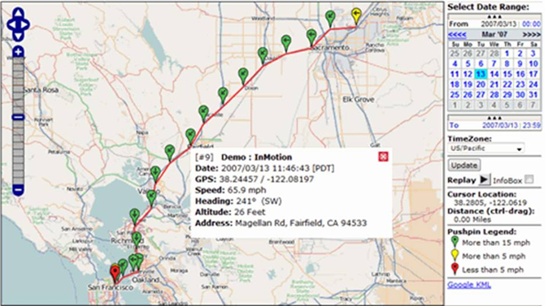
GEO Logging – GPS tracking

Slide 10
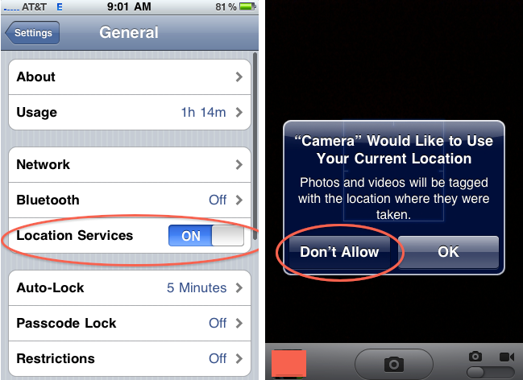
iPhone Geolocation Services

Slide 11
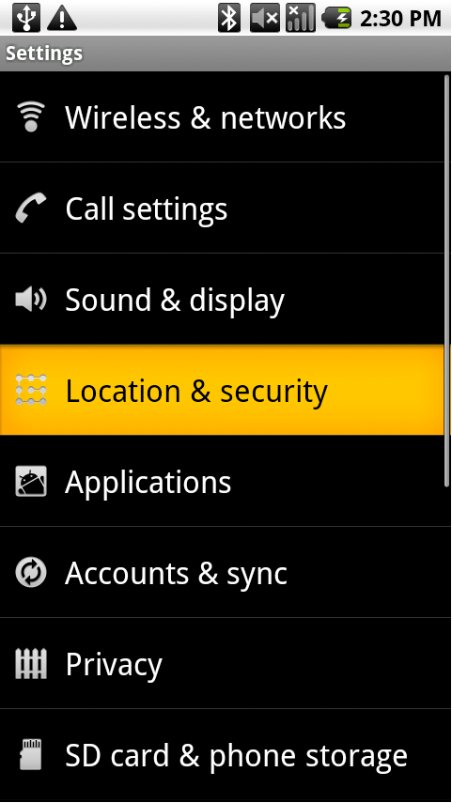
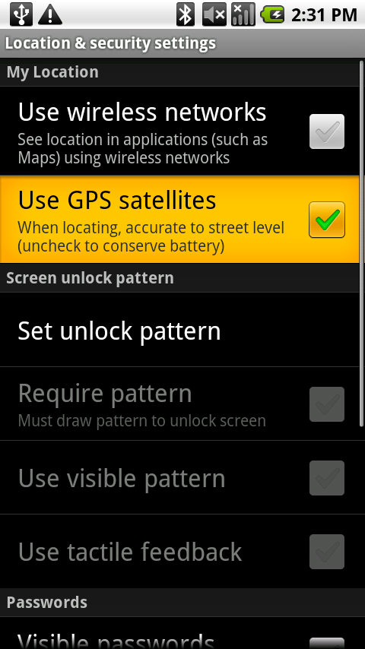
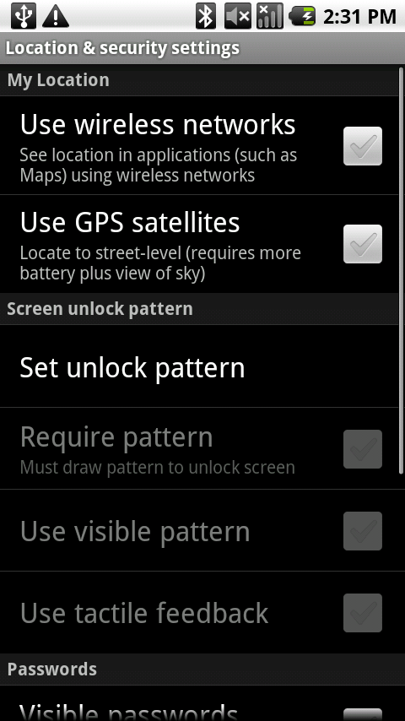
Android Geolocation

Slide 12
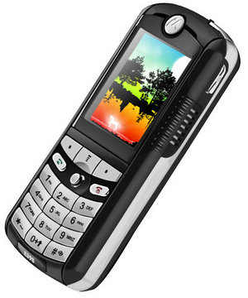
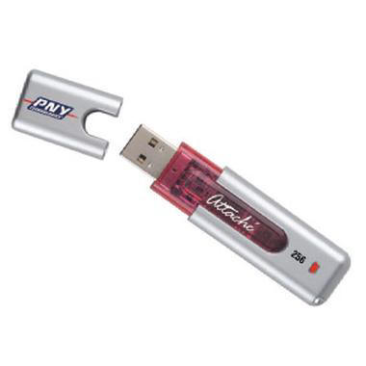
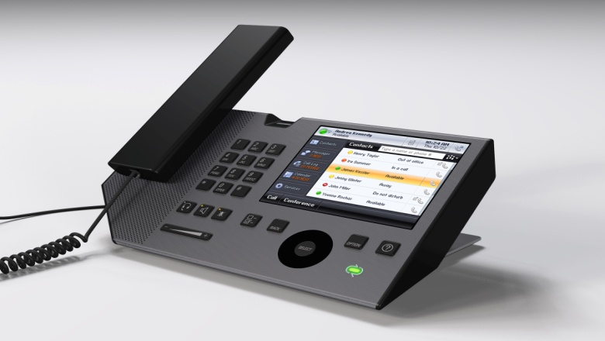
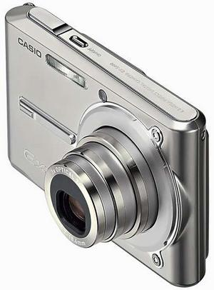
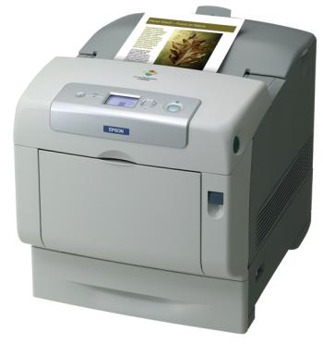
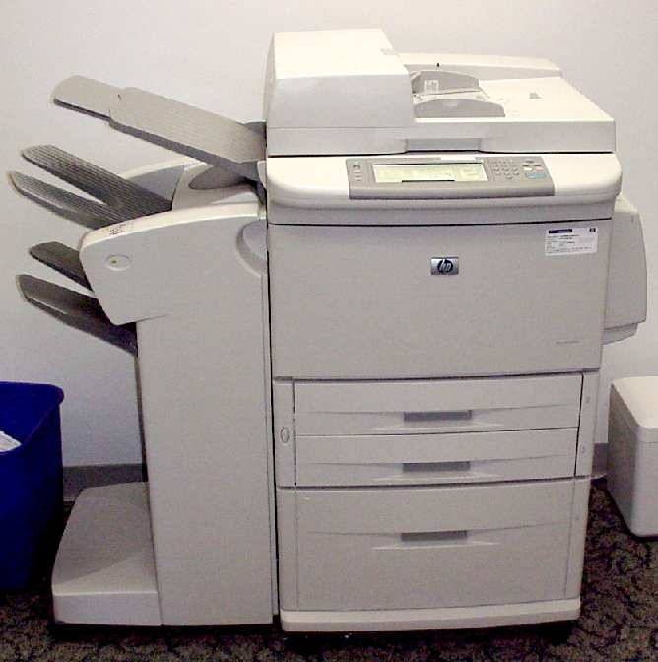
Computer Forensics is now
Digital Forensics

Slide 13
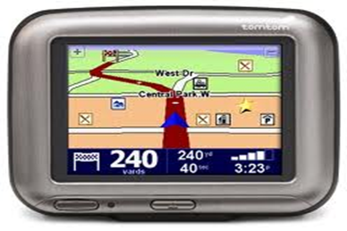
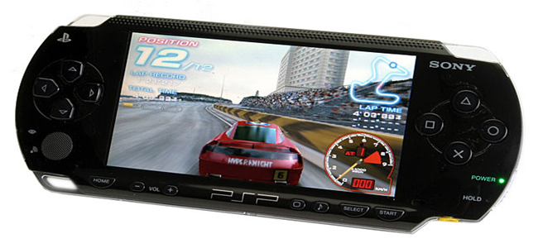

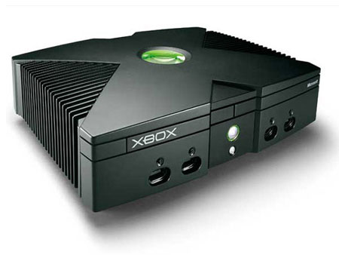
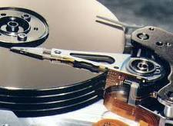
Computer Forensics is now
Digital Forensics

Slide 14
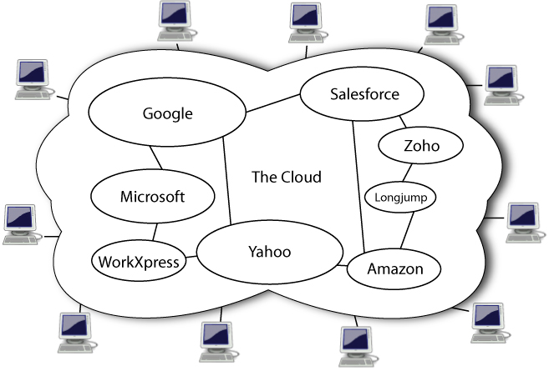
Cloud Computing

Slide 15
Cloud Computing Tools
MyDropbox
Docs.google
Skydrive
4shared
Box.net
Mozy
Streamload
Drop.io
Livedrive
sugarsync
MegaUpload
Yousendit
Idiskme
Carbonite
ibackup
My account
Idrive
Kineticd
Datadepositbox
Flipdrive……

Slide 16
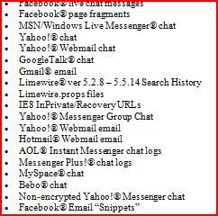
Social Networking Obtainable Data

Slide 17
Summary
Plethora of information available on phones today
  Whether someone was where they say they were or doing what they say they were doing
  Pictures tell a 1,000 words
The technological world continues to evolve
  Smartphones are mini-computers and data sometimes does not
  go any further than palm of the hand
  Cloud computing is here to stay and will grow in size
Consider all locations for computer/digital information

Slide 18
Expert Insights
Dependable
Defensible

Slide 19
Case Example –
Without Digital Forensics
7/14 (evening) Human Resource Department receives email from EE indicating he/she wants to meet with boss the next day
7/15 Terminates employment

Slide 20
Timeline with Computer Forensics
6/6 Warm fuzzies re: business r/ship (gmail)
6/11 Go to social event together (gmail)
6/15 Forwards resume to competitor (gmail)
6/17 Competitor invites EE to meeting on 6/19 (gmail)
6/19 EE attends meeting at competitor office (gmail)
6/20 (Sat) Install 1TB Backup storage device (USB)
6/20 Accesses company projects on server(recent)
6/20 (eve) Accesses company projects on server(recent)
6/20 (eve) Goes to Google documents account (cookie)
6/21 Apple computer in EE possession (deleted email)
6/22 Proprietary project files sent to competitor (gmail)

Slide 21
Timeline with Computer Forensics (continued)
6/22-6/28 Employment negotiations (gmail)
6/25 EE connects USB thumb drive in LT (USB)
6/25 EE accesses server/files from home laptop (recent)
7/8 EE connects card reader for first time (USB)
7/8 Empties trash (recover deleted files)
7/14 (evening):
  EE connects same backup drive to laptop (USB)
  EE accesses project files from server (recent)
  Email indicating EE wants to meet with boss (gmail)
  EE communicating with b/friend re: computer on BB (phone)
  EE access web mail account; forwards “opportunities” file (internet activity)
7/15 Terminates employment (from client)

Slide 22
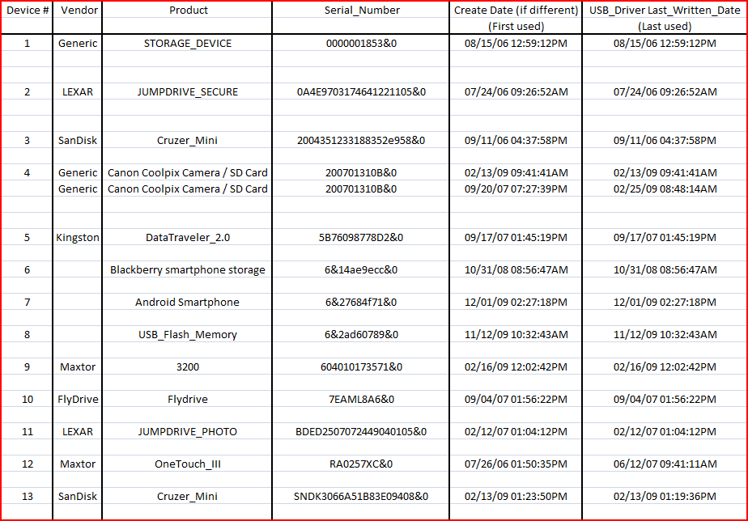
Sample USB Report

